Slide 1
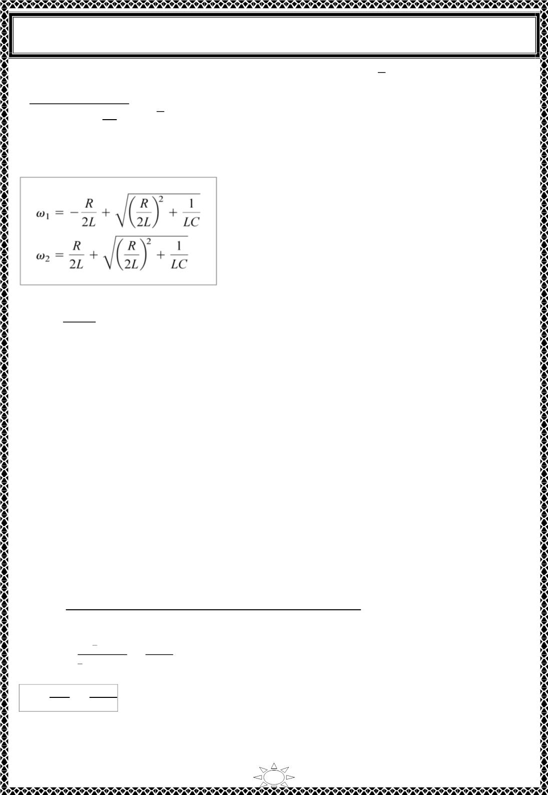
University of Diyala
Engineering College
Electrical Circuits
The half‐power frequencies are obtained by setting 푍 equal to √2푅 , and writing
1
ꢀ푅ꢁ + (휔퐿 − )ꢁ = √2푅
…(5.11)
…(5.12)
ꢂ퐶
Solving for 휔, we obtain
From Eqs. (5.5) and (5.12),
휔 = 휔 휔
ꢁ
…(5.13)
0
√
1
showing that the resonant frequency is the geometric mean of the half‐ power frequencies.
Notice that 휔 and 휔 are in general not symmetrical around the resonant frequency 휔 ,
Trail Version
Trail Version
Trail Version
Trail Version
Trail Version
Trail Version
Trail Version
Trail Version
Trail Version
Trail Version
Trail Version
Trail Version
Trail Version
1
ꢁ
0
because the frequency response is not generally symmetrical.
Although the height of the curve in Fig. 5.2 is determined by 푅, the width of the curve
depends on other factors. The width of the response curve depends on the bandwidth 푩,
which is defined as the difference between the two half‐power frequencies,
퐵 = 휔ꢁ − 휔₁
…(5.14)
The “sharpness” of the resonance in a resonant circuit is measured quantitatively by the
quality factor 푄 (dimensionless). At resonance, the reactive energy in the circuit oscillates
between the inductor and the capacitor. The quality factor relates the maximum or peak
energy stored to the energy dissipated in the circuit per cycle of oscillation:
푄 = 2휋
푃푒푎푘 푒푛푒푟푔푦 푠푡표푟푒푑 푖푛 푡ℎ푒 푐푖푟푐푢푖푡
…(5.15)
…(5.16)
…(5.17)
퐸푛푒푟푔푦 푑푖푠푠푖푝푎푡푒푑 푏푦 푡ℎ푒 푐푖푟푐푢푖푡 푖푛 표푛푒 푝푒푟푖표푑 푎푡 푟푒푠표푛푎푛푐푒
ꢃ
ꢄ
∴ 푄 = 2휋
ꢅ퐼^{ꢄ}
^{ꢁꢈ푓}ꢇ^{ꢅ}
ꢃ
ꢄ
=
퐼^{ꢄ}ꢆ(1/푓_{ꢇ})
ꢆ
ꢂ ꢅ
1
푄 = ^{ꢇ} =
ꢆ
ꢂ_{ꢇ}퐶ꢆ
The relationship between the bandwidth B and the quality factor Q is obtained by
substituting Eq. (5.12) into Eq. (5.14) and utilizing Eq. (5.17).
22

Slide 2
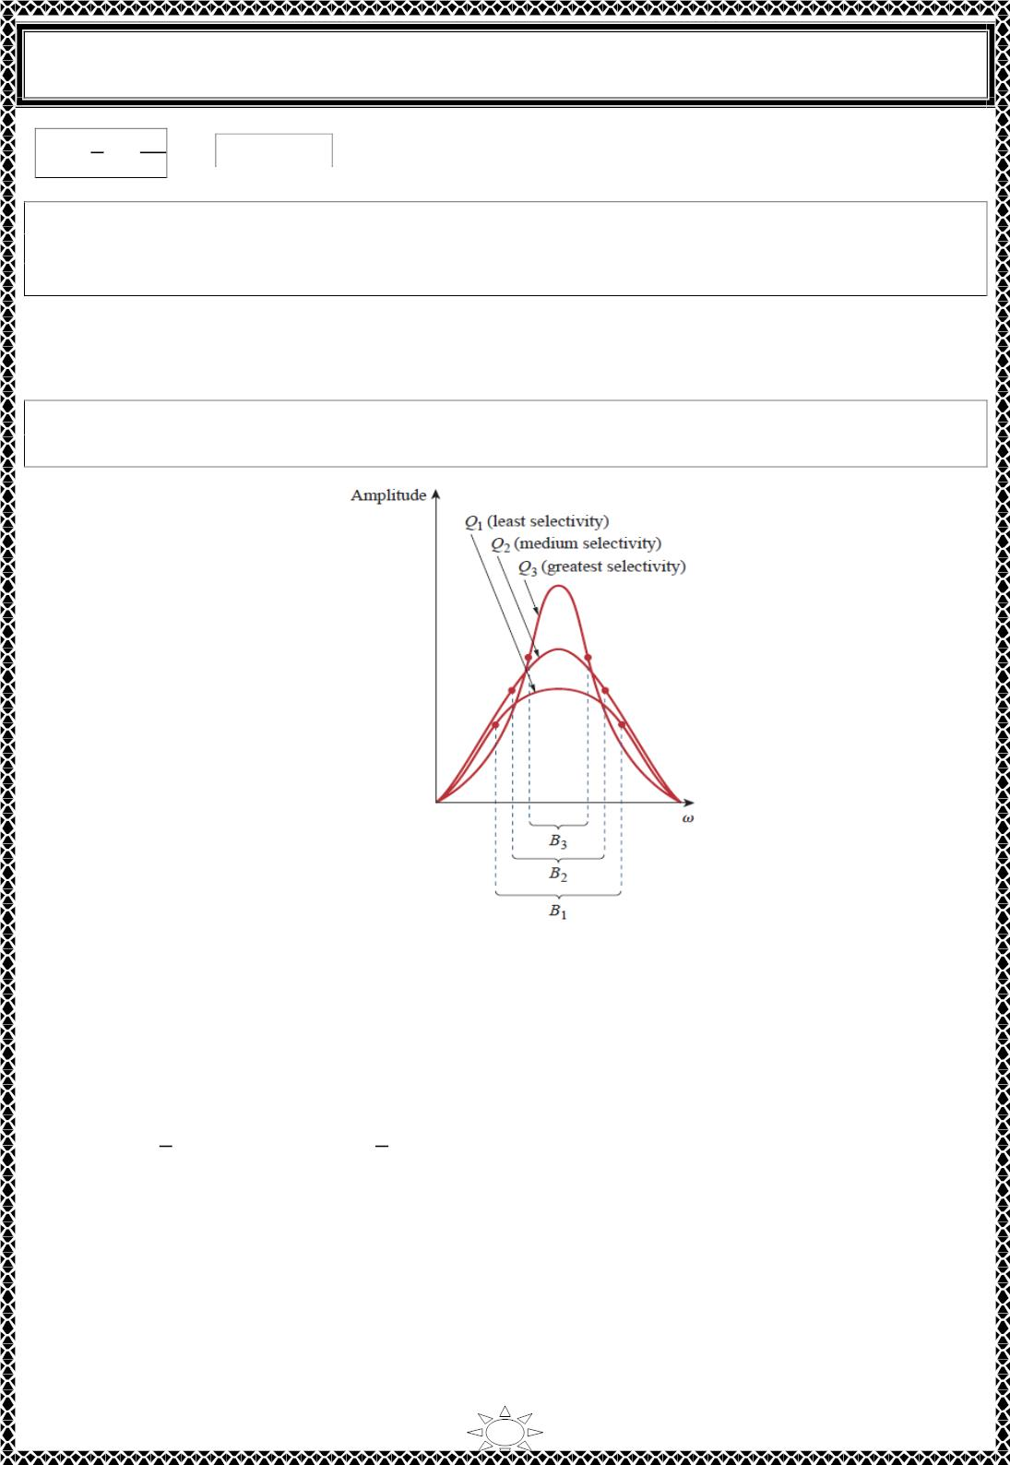
University of Diyala
Engineering College
Electrical Circuits
푅
휔
퐵 = = 0 or 퐵 = ꢀ²ꢁ퐶ꢂ
…(5.18)
퐿
푄
The quality factor of a resonant circuit is the ratio of its resonant frequency to its
bandwidth. The quality factor is a measure of the selectivity (or “sharpness” of
resonance) of the circuit.
Keep in mind that Eqs. (5.12), (5.17), and (5.18) only apply to a series RLC circuit. As
illustrated in Fig. 5.3, the higher the value of Q, the more selective the circuit is but the
smaller the bandwidth.
The selectivity of an RLC circuit is the ability of the circuit to respond to a certain
frequency and discriminate against all other frequencies.
Trail Version
Trail Version
Trail Version
Trail Version
Trail Version
Trail Version
Trail Version
Trail Version
Trail Version
Trail Version
Trail Version
Trail Version
Trail Version
Fig. 5.3 The higher the circuit Q, the smaller the bandwidth.
A resonant circuit is designed to operate at or near its resonant frequency. It is said to be a
high-Q circuit when its quality factor is equal to or greater than 10. For high-Q circuits (ꢃ ≥
1ꢁ) the half-power frequencies are, for all practical purposes, symmetrical around the
resonant frequency and can be approximated as
ꢆ
ꢆ
ꢀ ≈ ꢀ − .
ꢀ ≈ ꢀ +
…(5.19)
ꢄ
ꢅ
ꢇ
ꢇ
ꢅ
ꢇ
High‐ꢃ circuits are used often in communications networks.
We see that a resonant circuit is characterized by five related parameters: the two
half‐power frequencies 흎 and 흎 , the resonant frequency 흎 , the bandwidth 푩, and
the quality factor 푸.
ퟏ
ퟐ
ퟎ
23

Slide 3

University of Diyala
Engineering College
Electrical Circuits
Example 7: In the circuit of Fig. below, 푅 = 2훺, 퐿 = 1푚퐻,
and 퐶 = 0 ∙ 4휇퐹. (a) Find the resonant frequency and the
half‐power frequencies. (b) Calculate the quality factor and
bandwidth. (c) Determine the amplitude of the current at 휔 , 휔 ,
and 휔_{ꢂ}.
ꢀ
ꢁ
Solution:
ꢁ
ꢁ
(a) 휔ꢀ =
=
= 50 푘푟푎푑/푠
√ꢃꢄ
√ꢁꢀ×ꢀꢅ×ꢁꢀ36
METHOD 1 The lower & upper half‐power frequencies are
푅
푅
1
2
휔ꢁ = − + ꢆ( )^{ꢂ} +
2퐿 2퐿
퐿퐶
= −
2 × 10^{ꢇ3}
+ ꢈ(10³)^{ꢂ} + (50 × 10³)^{ꢂ} = −1 + √1 + 2500푘푟푎푑/푠 = 49푘푟푎푑/푠
휔_{ꢂ} = 1 + √1 + 2500푘푟푎푑/푠 = 51 푘푟푎푑/푠
(b) The bandwidth is 퐵 = 휔 − 휔 = 2푘푟푎푑/푠 or
ꢉ
퐵 = =
ꢃ
ꢂ
= 2푘푟푎푑/푠
ꢂ
ꢁ
ꢁꢀ^{ꢊꢋ}
휔ꢀ 50
Trail Version
Trail Version
Trail Version
Trail Version
Trail Version
Trail Version
Trail Version
Trail Version
Trail Version
Trail Version
Trail Version
Trail Version
푄 =
Trail Version
퐵
=
2
= 25
METHOD 2 Alternatively, we could find
푄 =
퐵 =
휔ꢀ퐿 50 × 10³ × 10^{ꢇ3}
푅
=
2
= 25
^{ꢌ}ꢍ
ꢎ
ꢏꢀ×ꢁꢀ^{ꢋ}
=
ꢂꢏ
= 2 푘푟푎푑|푠푠
Since 푄 > 10, this is a high‐Q circuit and we can obtain the half‐ power frequencies as
ꢐ
ꢐ
휔 = 휔 − = 50 −1 = 49푘푟푎푑/푠 & 휔 = 휔 + = 50 +1 = 51 푘푟푎푑/푠
ꢁ
ꢀ
ꢂ
ꢂ
ꢀ
ꢂ
푉
ꢂꢀ
ꢂ
ꢑ
(c) At 휔 = 휔ꢀ, 퐼 =
At 휔 = 휔ꢁ. 휔_{ꢂ}
=
= 10 퐴
ꢉ
푉
ꢁꢀ
√ꢂ
→ 퐼 =
ꢑ
=
= 7 ∙ 071 퐴
√ꢂꢉ
H.W.7: A series‐connected circuit has 푅 = 4훺 and 퐿 = 25푚퐻. (a) Calculate the value of
퐶 that will produce a quality factor of 50. (b) Find 휔 . 휔 . and 퐵. (c) Determine the
ꢁ
ꢂ
average power dissipated at 휔 = 휔 . 휔 . 휔 . Take ꢒ = 100ꢒ.
ꢀ
ꢁ
ꢂ
풓풂풅
ꢓ
풓풂풅
Answer: (a) 0.625 흁푭. (b) 7920 풓풂풅/풔, 8080
0.625 풌푾.
. ퟏퟔퟎ . (풄)ퟏ ∙ ퟐퟓ풌푾. 0.625 풌푾,
풔
풔
24

Slide 4
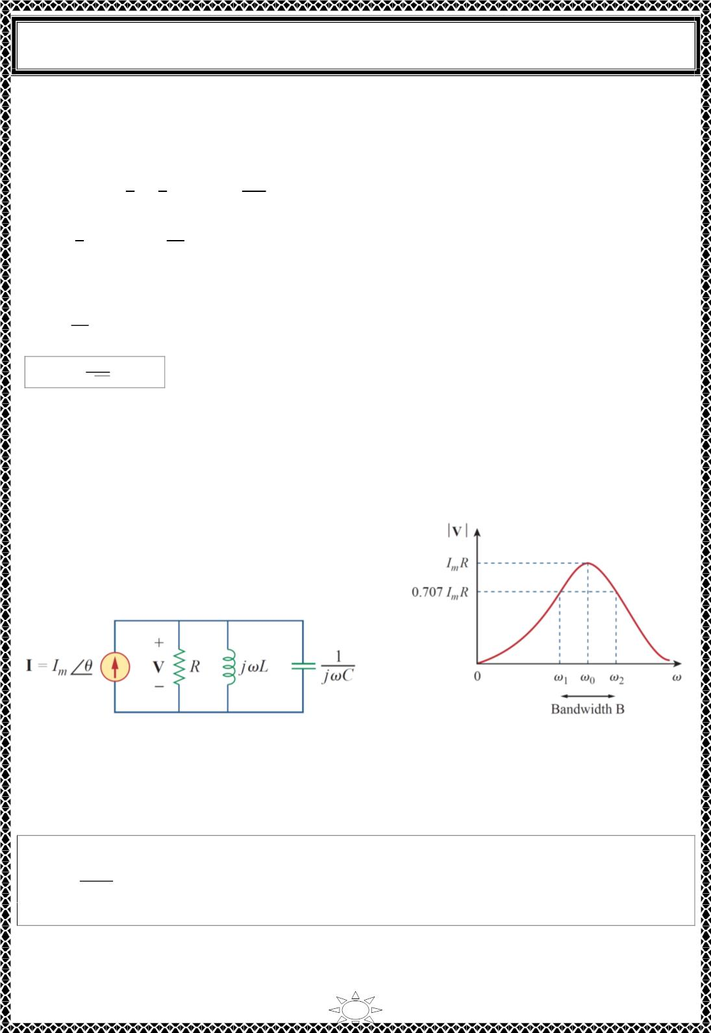
University of Diyala
Engineering College
Electrical Circuits
6) Parallel Resonance
The parallel RLC circuit in Fig. 6.1 is the dual of the series RLC circuit. So we will avoid
needless repetition. The admittance is
퐼
1
1
푌 = 퐻(휔) = = + 푗휔퐶 +
…(6.1)
…(6.2)
푉
푅
ꢀꢁ퐿
1
1
∴ 푌 = + 푗(휔퐶 −
)
푅
ꢁ퐿
Resonance occurs when the imaginary part of 푌 is zero,
1
휔퐶 − = 0
ꢁ퐿
…(6.3)
…(6.4)
1
∴ 휔_{ꢂ} =
푟푎푑/푠
√퐿ꢃ
which is the same as Eq. (5.5) for the series resonant circuit. The voltage |ꢄ| is sketched in
Fig. 6.2 as a function of frequency. Notice that at resonance, the parallel LC combination
acts like an open circuit, so that the entire current flows through R. Also, the inductor and
capacitor current can be much more than the source current at resonance.
Trail Version
Trail Version
Trail Version
Trail Version
Trail Version
Trail Version
Trail Version
Trail Version
Trail Version
Trail Version
Trail Version
Trail Version
Trail Version
Fig. 6.1 The parallel resonant circuit.
Fig. 6.2 The current amplitude versus
frequency for the series resonant
circuit of Fig. 6.1.
Notes:
푰 푹
|푰_{푳}| =
풎
= 푸푰_{풎}
흎 푳
ퟎ
|푰 | = 흎 푪푰 푹 = 푸푰 , where Q is the quality factor.
푪
ퟎ
풎
풎
25

Slide 5
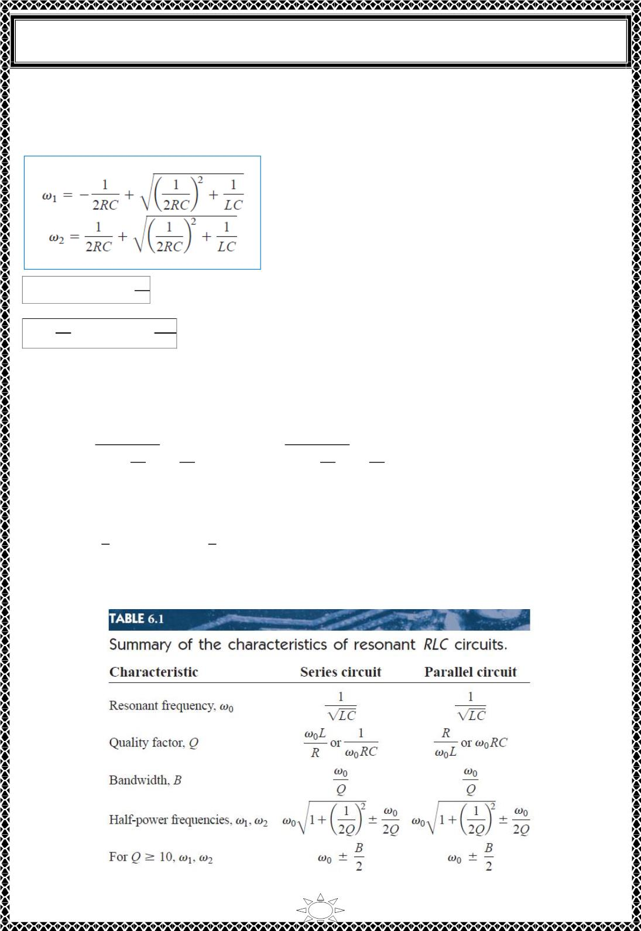
University of Diyala
Engineering College
Electrical Circuits
We exploit the duality between Fig. 5.1 and Fig. 6.1 by comparing Eq. (6.2) with Eq.
(5.2). By replacing R, L, and C in the expressions for the series circuit with 1/푅, 퐶, and 퐿
respectively, we obtain for the parallel circuit
…(6.5)
ꢀ
퐵 = 휔 − 휔 =
…(6.6)
…(6.7)
2
ꢀ
ꢁꢂ
^{ꢃ}0
ꢁ
푄 =
= 휔_{ꢅ}푅퐶 =
ꢄ
ꢃ ꢆ
0
It should be noted that Eqs. (6.5) to (6.7) apply only to a parallel 푅퐿퐶 circuit. Using Eqs.
(6.5) and (6.7) we can express the half‐ power frequencies in terms of the quality factor.
The result is
Trail Version
Trail Version
Trail Version
Trail Version
Trail Version
Trail Version
Trail Version
Trail Version
Trail Version
Trail Version
Trail Version
Trail Version
Trail Version
ꢀ
^{ꢃ}0
2ꢇ
ꢀ
^{ꢃ}0
2ꢇ
휔 = ω √1 + ( )² − ., 휔 = ω √1 + ( )² +
…(6.8)
ꢀ
표
2ꢇ
2
표
2ꢇ
Again, for high‐Q circuits (푄 ≥ 1ꢈ)
ꢄ
ꢄ
2
휔 ≃ 휔 − , 휔 ≃ 휔 +
…(6.9)
ꢀ
ꢅ
2
2
ꢅ
Table 6.1 presents a summary of the characteristics of the series and parallel resonant
circuits.
26

Slide 6
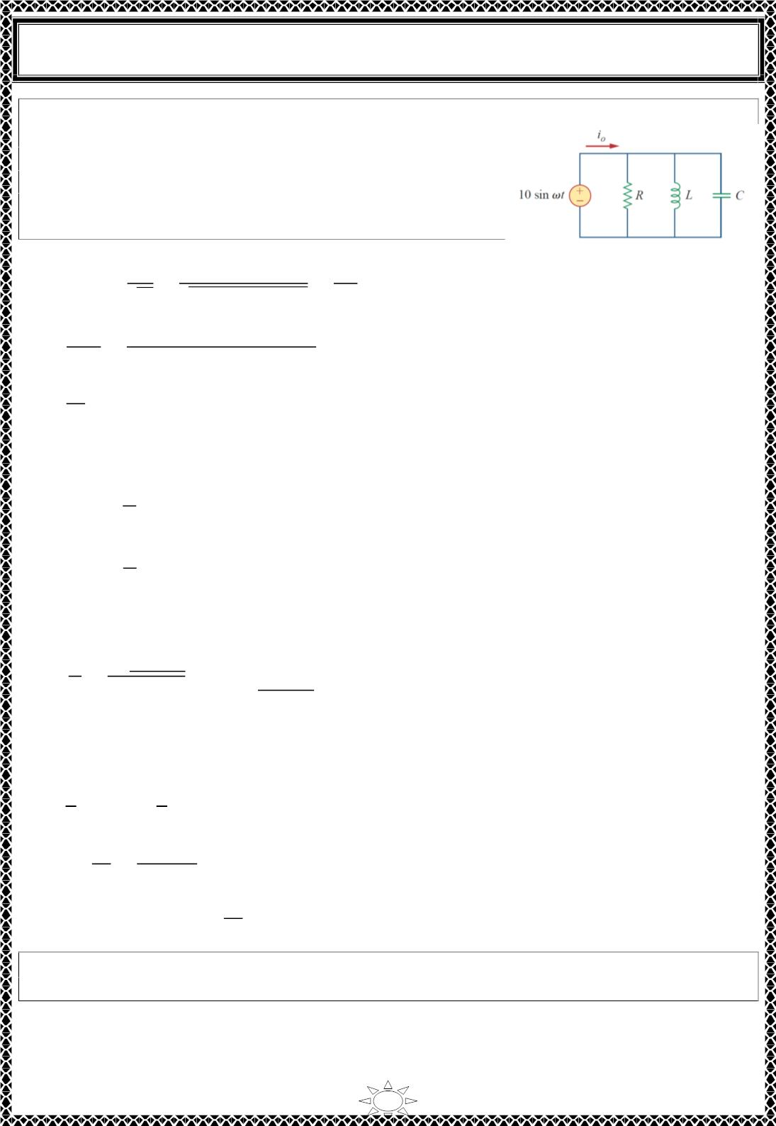
University of Diyala
Engineering College
Electrical Circuits
Example 8: In the parallel RLC circuit of Fig. shown, let 푅 = 8푘훺, 퐿 = 0 ∙ 2푚퐻 , and
퐶 = 8휇퐹. (a) Calculate 휔 , 푄, and 퐵. (b) Find 휔 and 휔 .
ꢀ
1
ꢁ
(c) Determine the power dissipated at 휔 ,휔 , and 휔 .
ꢀ
1
ꢁ
Solution:
(a) 휔ꢀ =
1ꢀ⁵
4
1
=
1
=
= 2ꢅ krad /푠
√ꢂꢃ
√ꢀꢁ×1ꢀ⁻³×ꢄ×1ꢀ−6
푄 =
퐵 =
푅
=
8 × ꢆ0^{ꢇ}
= ꢆꢉ00
휔ꢀ퐿 2ꢅ × ꢆ0^{ꢇ} × 0.2 × ꢆ0^{ꢈꢇ}
^{ꢊ}ꢋ
ꢌ
= ꢆꢅ ∙ ꢉ2ꢅ rad /푠
(b) Due to the high value of 푄, we can regard this as a high‐푄 circuit, Hence,
퐵
휔 = 휔 ꢍ = 2ꢅ000 ꢍ 7.8ꢆ2 = 2ꢎ992푟푎푑/푠
1
ꢀ
Trail Version
Trail Version
Trail Version
Trail Version
Trail Version
Trail Version
Trail Version
Trail Version
Trail Version
Trail Version
Trail Version
Trail Version
Trail Version
2
퐵
휔 = 휔 + = 2ꢅ000 + 7.8ꢆ2 = 2ꢅ008푟푎푑/푠
ꢁ
ꢀ
2
(c) At 휔 = 휔ꢀ, 푌 = ꢆ/푅 or 푍 = 푅 = 8푘훺. Then
푉
푍
ꢆ0/ꢍ90^{표}
8000
= ꢆ ∙ 2ꢅ/ꢍ90^{표}푚퐴
퐼_{표} =
=
Since the entire current flows through 푅 at resonance, the average power dissipated at 휔 =
휔ꢀ is
ꢆ
ꢆ
푃 = |퐼 |ꢁ푅 = (ꢆ ∙ 2ꢅ × ꢆ0^{ꢈꢇ})ꢁ(8 × ꢆ0^{ꢇ}) = ꢉ ∙ 2ꢅ푚푊
2
표
2
ꢑ
ꢏ
1ꢀꢀ
ꢐ
or 푃 =
=
= ꢉ ∙ 2ꢅ푚푊
ꢁꢒ
ꢁ×ꢄ×1ꢀ³
ꢑ
ꢏ
ꢐ
At 휔 = 휔 , 휔 , → 푃 =
= ꢓ ∙ ꢆ2ꢅ푚푊
1
ꢁ
4ꢒ
H.W.8: A parallel resonant circuit has 푅 = ꢆ00푘훺, 퐿 = 20푚퐻, and 퐶 = ꢅ푛퐹. Calculate
휔 , 휔 , 휔 , 푄, and B.
ꢀ
1
ꢁ
Answer: 100 풌풓풂풅/풔, ퟗퟗ풌풓풂풅/풔, ퟏퟎퟏ풌풓풂풅/풔, ퟓퟎ. ퟐ풌풓풂풅/풔 ∙
27

Slide 7
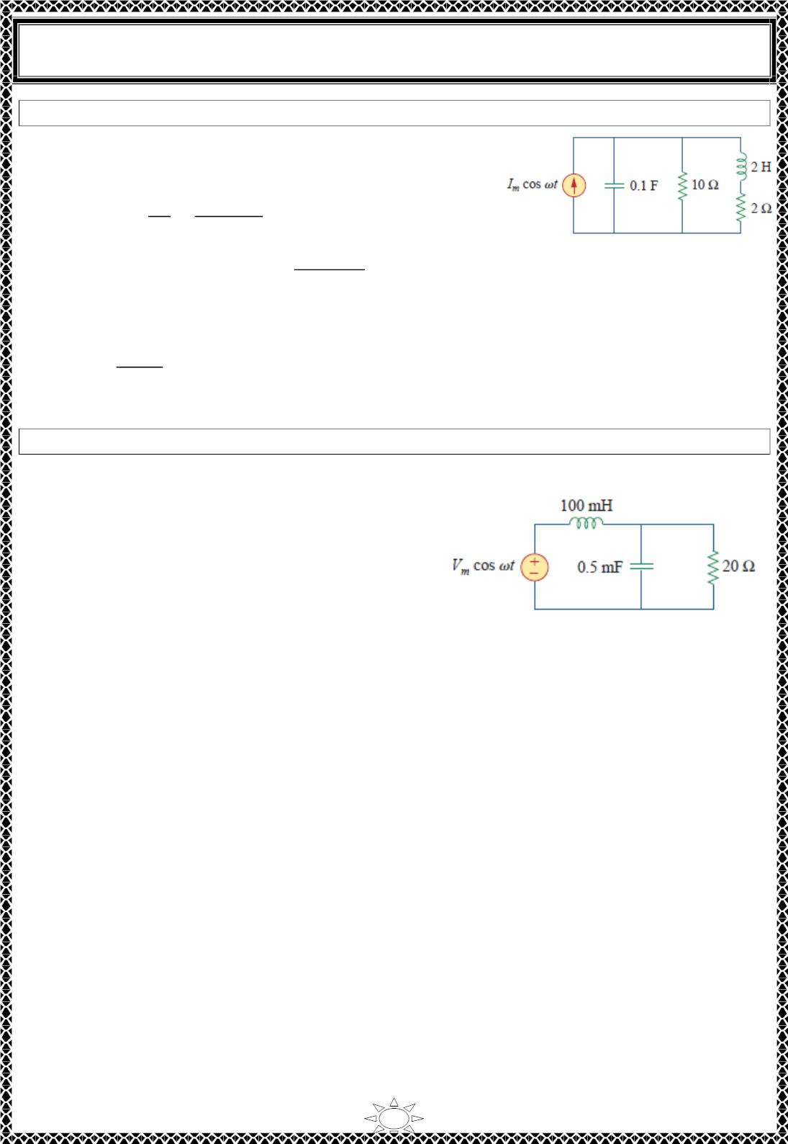
University of Diyala
Engineering College
Electrical Circuits
Example 9: Determine the resonant frequency of the circuit in Fig. shown.
Solution:
The input admittance is
푌 = 푗휔0 ∙ 1 +
1
+
1
10 2 + 푗휔2
= 0 ∙ 1 + 푗휔0 ∙ 1 +
2 − 푗휔2
4 + 4휔ꢀ
At resonance, Im (푌) = 0 and
휔ꢁ0 ∙ 1 −
^{ꢀꢂ}ꢃ
ꢄꢅꢄꢂ_{ꢃ}
= 0 ⇒ 휔ꢁ = 2 rad /푠
ꢆ
H.W.9: Calculate the resonant frequency of the circuit in Fig. shown.
Answer: 100 rad/s.
Trail Version
Trail Version
Trail Version
Trail Version
Trail Version
Trail Version
Trail Version
Trail Version
Trail Version
Trail Version
Trail Version
Trail Version
Trail Version
28

Slide 8
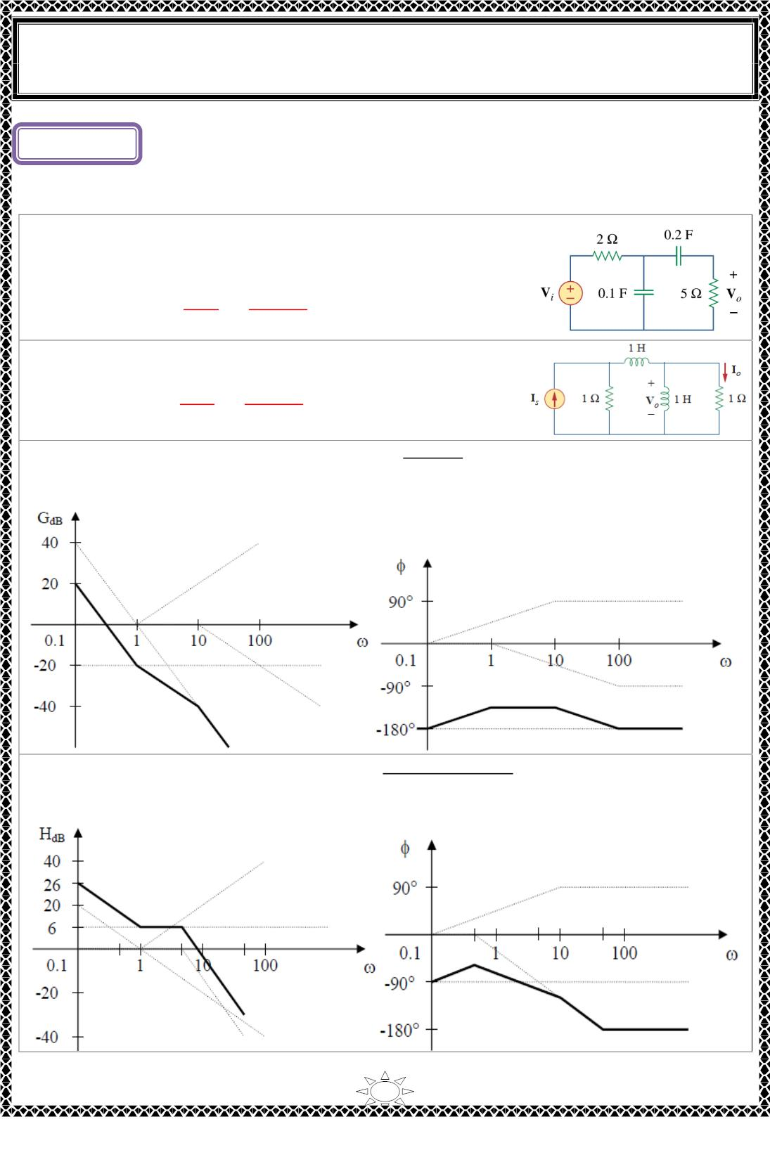
University of Diyala
Engineering College
Electronic Department
Electrical Circuits
2nd Class
Lecturer : Wisam N. AL-Obaidi
Year (2015-2016)
Lecture ()
Frequency Response
Problems
H.W.(1): For the circuit shown in Fig., find H(s) = Vo /Vi (s).
[Answer: 퐇(풔) =
^{푽}ퟎ^{(풔)}
푽_{풊}(풔)
=
ퟓ풔
]
풔^{ퟐ}+ퟖ풔+ퟓ
H.W.(2): For the circuit shown in Fig.,find H(s) = Io (s)/Is (s).
[Answer: 퐇(풔) =
^{푰}ퟎ ^{(풔)}
푰_{풔}(풔)
=
풔
]
풔^{ퟐ}+ퟑ풔+ퟏ
ꢀ+1
H.W.(3): Construct the Bode plots for 퐺(푠) =
[Answer:]
ꢀ²(ꢀ+10)
Trail Version
Trail Version
Trail Version
Trail Version
Trail Version
Trail Version
Trail Version
Trail Version
Trail Version
Trail Version
Trail Version
Trail Version
Trail Version
H.W.(4): Draw the Bode plots for 퐺(푗휔) =
50(ꢁꢂ+1)
[Answer:]
ꢁꢂ(−ꢂ²+10ꢁꢂ+ꢃ5)
1

Slide 9
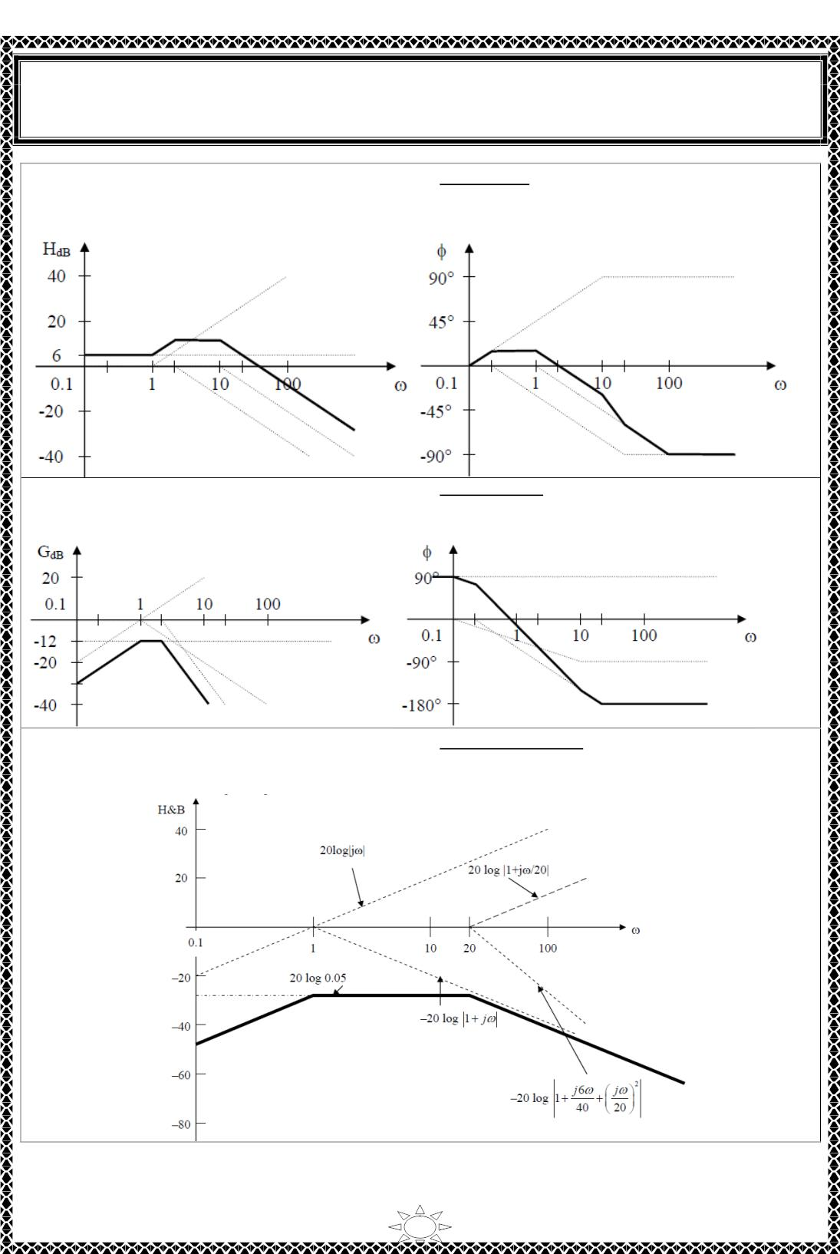
University of Diyala
Engineering College
Electronic Department
Electrical Circuits
2nd Class
Lecturer : Wisam N. AL-Obaidi
Year (2015-2016)
H.W.(5): Construct the Bode plots for 퐺(푠) =
40(ꢀ+1)
[Answer:]
(ꢀ+2)(ꢀ+10)
H.W.(6): Construct the Bode plots for 퐺(푠) =
ꢀ
[Answer:]
(ꢀ+2)ꢁ+ (ꢀ+1)
Trail Version
Trail Version
Trail Version
Trail Version
Trail Version
Trail Version
Trail Version
Trail Version
Trail Version
Trail Version
Trail Version
Trail Version
Trail Version
H.W.(7): Construct the Bode plots for 퐺(푠) =
ꢀ(ꢀ+20)
[Answer:]
(ꢀ+1)(ꢀꢁ+60ꢀ+400)
2

Slide 10
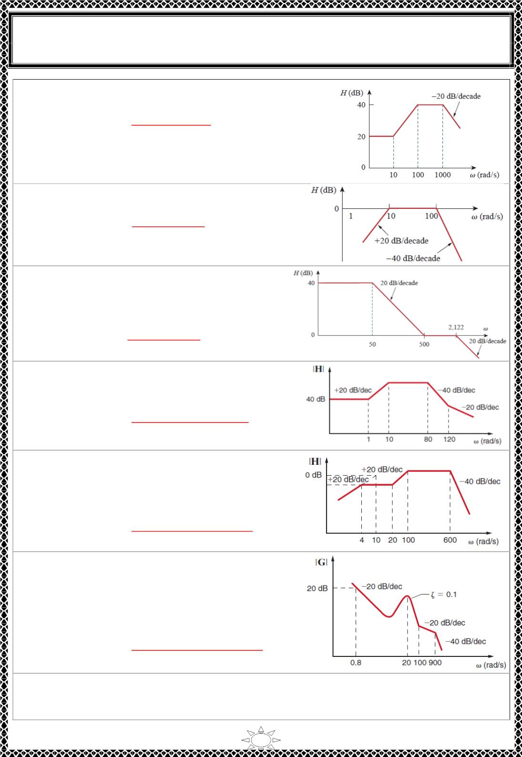
University of Diyala
Engineering College
Electronic Department
Electrical Circuits
2nd Class
Lecturer : Wisam N. AL-Obaidi
Year (2015-2016)
H.W.(8): Find the transfer function H(ω ) with the Bode
magnitude plot shown in Fig.
[Answer: 퐇(흎) =
ퟏퟎ^{ퟒ}(ퟐ+풋흎)
]
(ퟐퟎ+퐣훚)(ퟏퟎퟎ+퐣훚)
H.W.(9): The Bode magnitude plot of H(ω ) is
shown in Fig. Find H(ω ).
[Answer: 퐇(흎) =
ퟏퟎퟎ풋흎
]
(ퟏ+퐣훚)(ퟏퟎ+퐣훚)^{ퟐ}
H.W.(10): The magnitude plot in Fig. represents
the transfer function of a preamplifier. Find H(s).
[Answer: 퐇(풔) =
ퟖퟒퟖퟖ(풔+ퟓퟎퟎ)
]
Trail Version
Trail Version
Trail Version
Trail Version
Trail Version
Trail Version
Trail Version
Trail Version
Trail Version
Trail Version
Trail Version
Trail Version
Trail Version
(퐬+ퟓퟎ)(퐬+ퟐퟏퟐퟐ)
H.W.(11): Find the transfer function H(ω ) with
the Bode magnitude plot shown in Fig.
[Answer: 퐇(흎) =
ퟓ.ퟑퟑ×ퟏퟎ^{ퟒ}(ퟏ+풋흎)(ퟏퟐퟎ+풋흎)
(ퟏퟎ+퐣훚)(ퟖퟎ+퐣훚)^{ퟐ}
]
H.W.(12): Find the transfer function H(ω ) with
the Bode magnitude plot shown in Fig.
[Answer: 퐇(흎) =
ퟕ.ퟐ×ퟏퟎ^{ퟓ}(풋흎)(ퟐퟎ+풋흎)
_{(ퟒ+퐣훚)(ퟏퟎퟎ+퐣훚)(ퟔퟎퟎ+퐣훚)ퟐ}]
H.W.(13): Find the transfer function H(ω ) with
the Bode magnitude plot shown in Fig.
[Answer: 퐇(흎) =
ퟐퟖퟖ(ퟏퟎퟎ+퐣훚)^{ퟐ}
_{퐣훚(ퟗퟎퟎ+퐣훚)[(퐣훚)ퟐ+ퟒ풋흎+ퟒퟎퟎ]}]
H.W.(14): Design a parallel resonant RLC circuit with ω₀ = 10 rad/s and Q = 20. Calculate
the bandwidth of the circuit. Let R = 10 Ω .
[Answer: 8.796x10⁶ rad/s]
3

